Slide 1
APRN Roles- A Case Study
By: Angel Hobbs

Slide 2

Maria is an FNP in a small, rural, privately owned health care office. She sees a variety of patients, including Pediatrics. During a normal work week, she sees many patients who are coming in for ER follow-ups from surrounding hospitals. Many times, Maria’s patients have to wait in the exam room while she waits on the nurse to call the ER and get records.

Slide 3
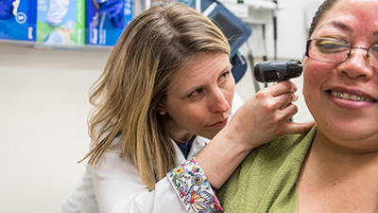
Maria discusses the situation with the office manager and contacts the local hospitals to implement access to patient records for continuum of care. The two facilities collaborate and decide to set up a log in for the nurses at Maria’s facilities to implement access to records.

Slide 4

Within a two-week period, Maria has access to printed records from ER visits, hospital stays, and specialty visits. The patients are now being seen in a timely manner and are not waiting for records to be faxed to their PCP.

Slide 5
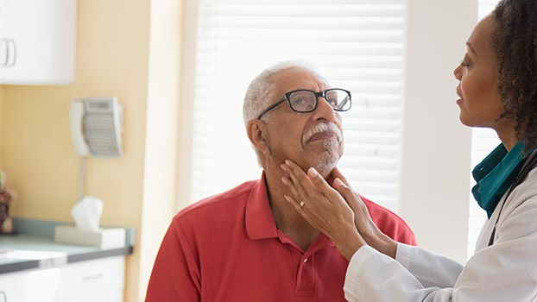
By collaborating with her office manager and the local hospitals, Maria’s patients are seen in a timely manner, there is detailed charting of what medication’s her patients are on and what they took in the hospital, procedures done, diagnosis's, and if there are any specialty referrals to follow-up with.

Slide 6
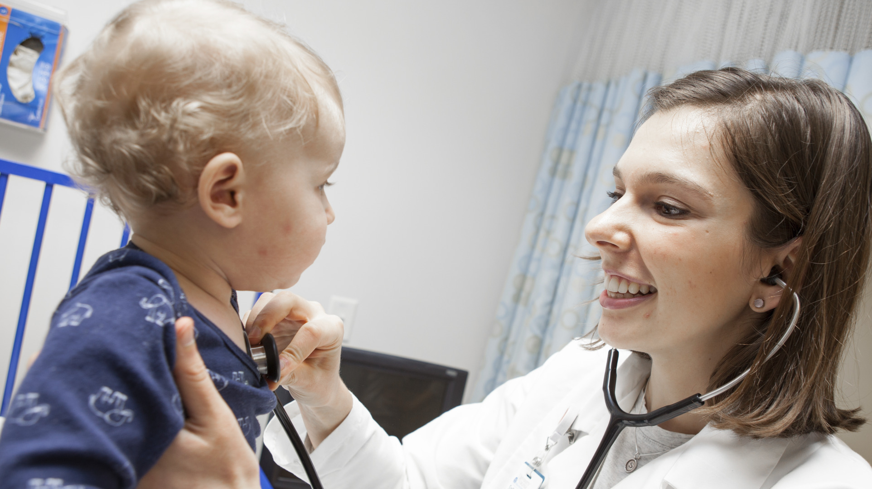
With interdisciplinary collaboration and gaining access to another facilities EMR records, What role do you think Maria has displayed in her Nurse Practitioner role?

Slide 7


