Slide 1
Healthy People 2020 Health Issue Assignment
By: Angel Hobbs
King University

Slide 2

Objective: Reduce pregnancies among adolescent females aged 15 to 17 years
Why did you select this objective?
I selected this objective because I have seen many teenage girls during my clinicals who come in wanting to talk about birth control options, and I feel that education is still key in pregnancy prevention.

Slide 3
Research the issue. Why is this objective on the Healthy People 2020 objectives list?
According to the CDC, “Teenage pregnancies in the United States have declined to the lowest rates seen in seven decades, yet still ranks the highest compared to other developed countries (2020).” Teenagers go through a change for not only how they think, feel, and interact with others, but also how their bodies are developing and changing. They begin to have an interest in romantic relationships and sexuality. According to the U.S. Department of Health & Human Services, “Young people between the ages of 15-24 account for nearly one-half of all new cases of sexually transmitted diseases. While there is great progress in reducing teen birth rates, there are 40.2 pregnancies per 1,000 females ages 15-17 years of age (2020).”
The goal of Healthy People 2020 is to reduce teen birth rates from 40.2 pregnancies per 1,000 to 36.2 pregnancies per 1,000 (2020).

Slide 4
Discuss your strategy for how you might address the issue in a clinical site.
A. How do you plan to gain permission from administration, co-workers, patients or others?
At the clinic, I would gain permission from administration and co-workers by writing a professional letter addressing the need of once weekly clinics to talk to teenagers about sex education and pregnancy prevention. I would contain the lecture material and have the educational lecture in the clinic after hours if permission were to be granted.
B. How do you plan to implement your idea?
I would start by volunteering to lecture at our local middle school and high school for sex education. I would address this with the Board of Education and send out notifications to parents for consent to attend. I would also inform my patients that I would be having an after-hours sex education, teenage pregnancy prevention, and sexually transmitted diseases lecture. Hopefully this would provoke parents to send their teenagers to the lecture.

Slide 5
Discuss your strategy for how you might address the issue in a clinical site (Continued).
C. How do you plan to evaluate the effectiveness of the intervention?
Not only will I keep statistical data with my patients, I will keep data on kids coming to lecture. I will also keep undated on statistical data via the Health Department.
D. Discuss how much it would cost to implement your idea and how this cost would be covered.
The cost would be covered using state funded grant for essentials to lecture and teach. It will cost approximately $12 per person to supply free condoms. As healthcare providers, we play a critical role in further reducing teen pregnancy rates through the care we provide our adolescent patients.

Slide 6

Facts
Between the ages of 15 & 17, most girls will be physically mature by now, and most will have completed puberty. “During this time, your teen is developing her unique personality. She may began to feel sadness or depression, which can lead to poor grades, alcohol or drug abuse and unsafe sex (CDC, 2020).”
According to Planned Parenting, “Teen mothers are less likely to graduate from high school and more likely than their peers, who delayed childbearing, to live in poverty and rely on welfare (2018).”
According to The American College of Obstetrics and Gynecology (ACOG), “Dual method use-the use of condoms in combination with long-acting reversible contraception (LARC) is the ideal contraceptive practice for adolescents (2017).”

Slide 7
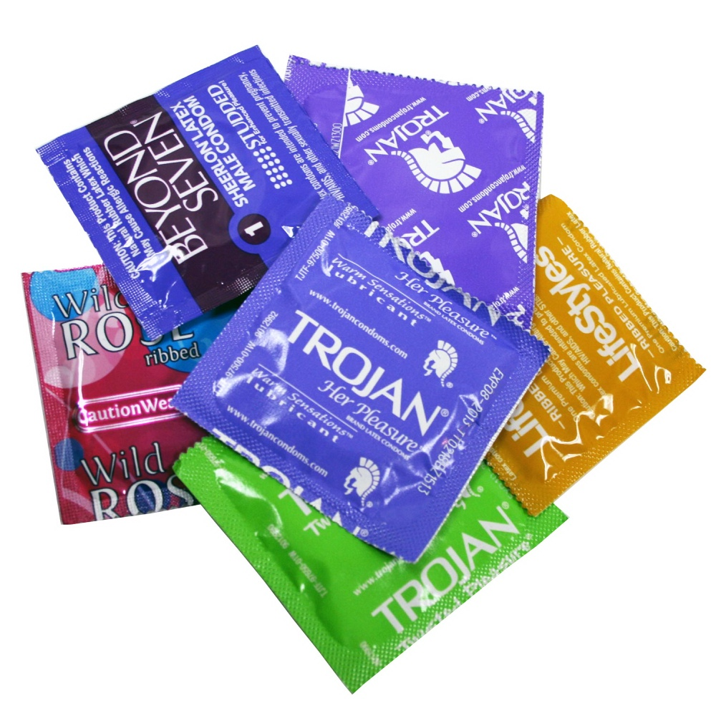
Give Them Something to Talk About
Most adolescents are embarrassed to talk about safe sex practices. However, according to Planned Parenthood, “Talking to your partner about preventing STDs and unplanned pregnancy is one of the most important things you can do to protect your sexual health, and it’s an important part of being sexually active (2018).”

Slide 8
References
Adolescence (15-17 years old). (2020, March 6). Retrieved March 19, 2020, from https://www.cdc.gov/ncbddd/childdevelopment/positiveparenting/adolescence2.html
Adolescent Pregnancy, Contraception, and Sexual Activity. (2017, May). Retrieved March 19, 2020, from https://www.acog.org/clinical/clinical-guidance/committee-opinion/articles/2017/05/adolescent-pregnancy-contraception-and-sexual-activity
Evidence-Based Resource Summary. (2019). Retrieved March 19, 2020, from https://www.healthypeople.gov/2020/tools-resources/evidence-based-resource/teen-pregnancy-prevention-resource-center-evidence
Health Care Providers and Teen Pregnancy Prevention. (2020, February 27). Retrieved March 19, 2020, from https://www.cdc.gov/teenpregnancy/health-care-providers/index.htm
Hhs.gov. (2019, July 12). About TPP. Retrieved March 19, 2020, from https://www.hhs.gov/ash/oah/grant-programs/teen-pregnancy-prevention-program-tpp/about/index.html
How Teens Can Practice Safer Sex & Birth Control. (2018). Retrieved 19 March 2020, from https://www.plannedparenthood.org/learn/teens/relationships/all-about-communication/talking-your-partner-about-condoms-and-birth-control

