Slide 1
Water Safety
By: Angel Hobbs, Eric Beaulieu, Misty Mabe, Candy Bush & Christina Perkins

Slide 2

Introduction/Statistics
“An estimate of around 85% of drownings are preventable with adequate supervision, swimming instruction, and education.” (Conover & Romero, 2018)
“Drownings are the leading cause of injury death for children ages 1-14, and three children die every day due to drowning” (CDC, 2019).
“74% of drowning incidents for children younger than 15 between 2015 and 2017 occurred in residential locations” (NSC, 2020, para. 5).
“Drowning remains one of the leading causes of preventable deaths for children in the U.S., with nearly 800 deaths each year” (Cohen, 2019).
(Google Image, n.d)

Slide 3
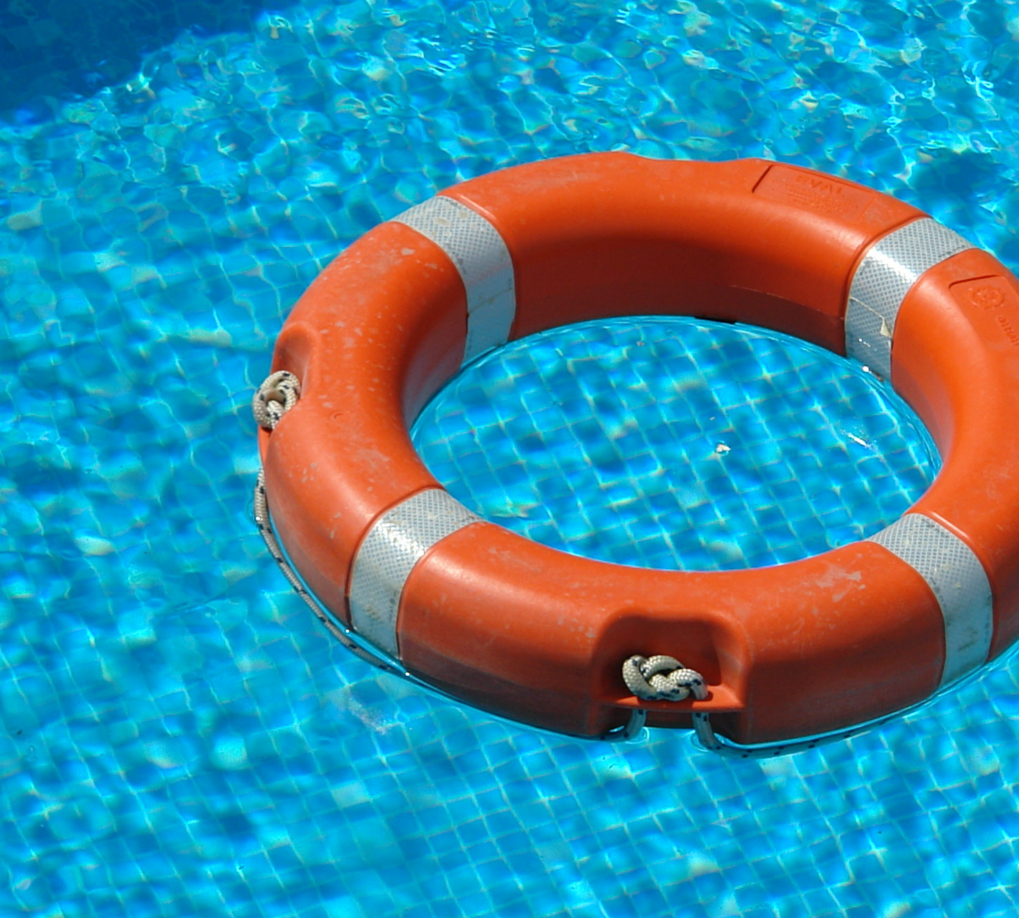
Who’s at Risk?
“Every day, about ten people die from unintentional drowning. Of these, two are children aged 14 or younger” (CDC, 2020, para. 1).
“Children, males and individuals with increased access to water are most at risk of drowning” (WHO, 2020, para. 1).
“low- and middle-income countries account for over 90% of unintentional drowning deaths” (WHO, 2020, para. 4).
“This relationship is often associated with a lapse in supervision. Globally, the highest drowning rates are among children 1–4 years, followed by children 5–9 years” (WHO, 2020, para. 8).
(Google Image, n.d.)

Slide 4
Prevention:
Lifeguards-lifeguards help to enforce safety regulations (such as running and pool/beach safety), and raise awareness about important weather considerations (such as storms), therefore, helping decrease drowning incidence(Conover & Romero, 2018).
Pool Safety- evidence supports the importance of pool isolation fencing in drowning prevention.
Learn Life Saving Skills- Teach life saving skills such as floating, CPR, and safe water levels.
Constant Adult Supervision- for children, with bathing or swimming- the most effective way to prevent drowning is adult supervision.
Swimming Lessons & Water Safety- Swimming lessons along with teaching water safety help with drowning prevention.
Floatation Devices- Well fitting personal floatation devices increase mortality rates.

Slide 5
Infant Swimming Resources (ISR) Training:
“Founded in 1966 by Dr. Harvey Barnett, ISR is now the global leader in the industry it pioneered: survival swimming lessons for infants and young children” (Barnett, 2020, para. 1).
“ISR’s core conviction is that the child is the most important part of a drowning prevention strategy and our over 300,000 ISR graduates and 800 documented survival stories are proof that children can save themselves” (Barnett, 2020, para. 4).
ISR performs one on one training with only the instructor and the child in the water.
Children 6 months to 12 months of age lean the ISR Self-Rescue skill of rolling over onto their back to float, rest and breathe. They are taught to maintain this position until help arrives.
Children 1 -6 years old learn the full ISR Self-Rescue training. This is a sequence of swimming until they need air, rotating on their back to rest, then rolling back over and continue swimming.
ISR has 5 important keys to water safety
1. Effective Supervision: The most crucial line of defense is adult supervision. Local ISR classes give out a water guardian tag to assign an adult to water supervision.
2. Fences around pools: A 4 sided fence at least 3-5 feet away from the pool.
3. Alarms: Every door and window with access to a pool are locked and alarmed.
4. Survival Swimming: Every child should be taught water survival skills.
5. CPR: Every adult should be trained to perform CPR.

Slide 6
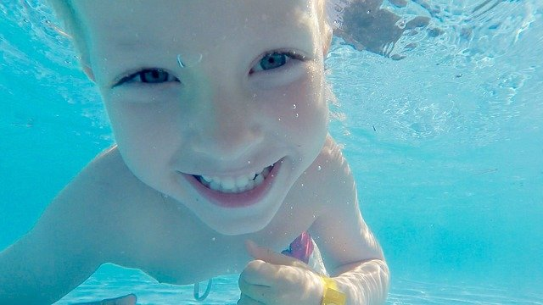
Activities for different age groups:
Popsicle Freeze Tag
  A pool-themed version of freeze tag. Swim between the frozen person’s legs to unfreeze them.
Treasure Hunt
  Use fun toys in the pool and let kids dive for hidden treasure.
Pool Volleyball
  An inflatable net and ball will really get the kids moving in the pool.
Basketball
  Use an inflatable basketball goal in the pool and have fun.
Google image, n.d.

Slide 7
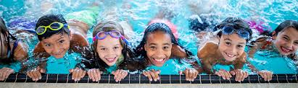
Activities for Different Age Groups, Cont.
Watermelon Relay
  Grease up a watermelon with oil and place in the pool. Then let the kids try to push it from one end of the pool to the other Very entertaining.
Squirt Gun Races
  Punch a hole in a plastic cup and run a string from one side of the pool through the cup and to the other side. Use a squirt gun to be the first one to get the cup across the pool.
The Lost Bottle
  Use a clear bottle filled with water and begin a scavenger hunt. Everyone will search for the “invisible” bottle.
Spongeball
  Use a spongeball and turn a few Frisbees upside down and add numbers for scoring. This is now a floating ring toss game. (Cavoto, 2020)
Google image (n.d.)

Slide 8

Appropriate Certified Devices:
How to Select A Personal Flotation Device:
  Follow U. S Coast Guard Standards.
  Life Jacket for Kids Rules:
  ”Fit is important in keeping a child's head above water, so do not get a too-big PFD thinking he or she will grow into it” (REI, 2020).
Sizing for a youngster depends on his or her weight (and not chest size, as it does with adults):
  Infant PFDs: 8 to 30 pounds
  Child PFDs: 30 to 50 pounds
  Youth PFDs: 50 to 90 pounds
  For infants and small children, a PFD should have a:
  Padded head support to help keep the child’s head above water.
  Grab handle to assist retrieving the child out of the water.
  Crotch strap to help keep the PFD from riding up.
  Youth-sized PFDs look like, and have the same features as, adult PFDs. The more straps a PFD has, the more adjustments can be made for sizing. (REI, 2020).
  What NOT to Use.
  “Water wings, swim rings, inflatable toys and other items designed for water recreation are not substitutes for U.S. Coast Guard-approved life jackets or adult supervision. These devices enable swimmers to go beyond their ability. For those with little or no swimming skill, a fall off one of these devices could lead to a drowning situation. Additionally, the materials used for these devices deteriorate in sun and rough pool surfaces, leading to deflation and leaks” (Seasons for HOA, 2020).
WSF Boating & Paddling Safety, 2020.

Slide 9
Appropriate Certified Devices/ Part II
  There are 5 categories of PFDs, but most children and youths should use a Type III USCG-approved model. PFDs for infants are often a Type II design.
  Type III: Flotation Aids. These are suitable for various sports activities and the most comfortable for continuous wear and freedom of movement. They are good for where there is a quick chance of rescue. They are designed so wearers can put themselves in a face-up position, but they may have to tilt their head back to avoid being face down in water.
  Type II: Near-shore Vests. Calm inland waters, where there is a likely chance of a fast rescue, is the intent of these PFDs. They will turn some unconscious wearers to the face-up position but not all of them. (REI, 2020).
  Fitting & Wearing a Life Jacket
  “As with an adult's PFD, a child's PFD must fit snugly. Check the fit once the child is secured in it. Pick the child up by the shoulders of the PFD. The child's chin and ears should not slip through” (REI, 2020).
  “Babies and toddlers sometimes "hate" their PFD. This catches many parents by surprise. If possible, prepare youngsters ahead of time at home. Offer a reward for keeping it on or make a game of it” (REI, 2020).

Slide 10
References:
Barnett, J. (2020). About Us. Retrieved from https://www.infantswim.com/about-isr/about-isr.html
Cavoto, E. (2020, February 24). 20 Best Swimming Pool Games to Play This Summer. Retrieved from CountryLiving: https://www.countryliving.com/life/kids-pets/g4184/swimming-pool-games/
Centers for Disease Control and Prevention (2020). Unintentional Drowning: Get the Facts. Retrieved from https://www.cdc.gov/homeandrecreationalsafety/water-safety/waterinjuries-factsheet.html
Cohen, J. (2019). The ultimate guide to swimming safety | Children's National. Retrieved 25 October 2020, from https://riseandshine.childrensnational.org/the-ultimate-guide-to-swimming-safety/
Conover, K., & Romero, S. (2018). Drowning Prevention in Pediatrics. Pediatric Annals, 47(3), e112–e117. https://doi.org/10.3928/19382359-20180220-02
Drowning Prevention | Child Safety and Injury Prevention| CDC Injury Center. (2019). Retrieved 1 October 2020, from https://www.cdc.gov/safechild/drowning/index.html
Google Image (n.d.). American red cross. Retrieved from https://www.google.com/search?q=pictures+of+drowning&source=lnms&tbm=isch&sa=X&ved=2ahUKEwi847-oss7sAhUMw1kKHeMwDsEQ_AUoAXoECA4QAw&biw=1366&bih=638#imgrc=8tpu-f2T2xq7qM

Slide 11
References
Google Image (n.d.) Children’s National. Retrieved 25 October 2020, from https://riseandshine.childrensnational.org/the-ultimate-guide-to-swimming-safety/
Google Image (n.d.) Retrieved 25 October 2020, from https://www.istockphoto.com/photos/drowning?mediatype
How to Choose PFDs (Life Jackets) for Kids. (2020). Retrieved October 07, 2020, from https://www.rei.com/learn/expert-advice/kids-personal-flotation-device.html
Legacy Publication. (2018). Retrieved October 07, 2020, from https://www.bts.gov/archive/publications/maritime_trade_and_transportation/2007/table_05_03U.S Coast Guard Approved Information. (2020). Retrieved October 07, 2020, from http://www.seasonsfourhoa.com/us-coast-guard-approved-information.html
National Safety Council (2020). Drowning: It Can Happen in an Instant. Retrieved from https://www.nsc.org/home-safety/tools-resources/seasonal-safety/drowning
World Health Organization (2020). Drowning. Retrieved from https://www.who.int/news-room/fact-sheets/detail/drowning
WSF Boating & Paddling Safety (Director). (2020). Properly sizing children's life jackets [Video file]. Retrieved 2020, from https://www.youtube.com/watch?v=opoZM5RVS0c

