Slide 1
Osteoporosis
Angel Hobbs

Slide 2
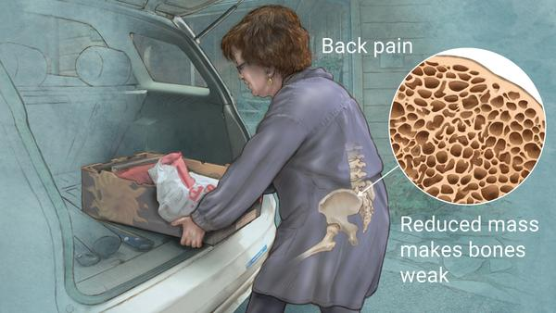
Osteoporosis is defined as a medical condition in which the bones become brittle and fragile from loss of tissue, typically as a result of hormonal changes, or deficiency of calcium or vitamin D. A decrease in the mineralization and strength of the bones over time causes osteoporosis.
The leading cause of osteoporosis is a lack of certain hormones, particularly estrogen in women and androgen in men. Women, especially those older than 60 years of age, are frequently diagnosed with the disease.
Menopause is accompanied by lower estrogen levels and increases a woman's risk for osteoporosis.

Slide 3
Signs & Symptoms
There typically are no symptoms in the early stages of bone loss. But once your bones have been weakened by osteoporosis, you might have signs and symptoms that include:
Back pain, caused by a fractured or collapsed vertebra
Loss of height over time
A stooped posture
A bone that breaks much more easily than expected
You might want to talk to your doctor about osteoporosis if you went through early menopause or took corticosteroids for several months at a time, or if either of your parents had hip fractures.

Slide 4

Case Study- Marge
64 y/o female presents to the office c/o mild back pain for 2 weeks. States that she has noticed that her nails have become brittle and are easily broken when she gardens. Pt also states that when she is always dropping things and has noticed that her grips are not strong anymore.
Medical HX: G3P3, seasonal allergies, post-menopausal, nervous breakdown (1992)
Surgical HX: T&A as a child, Lap Chole (1990) for Gallstones
NKDA
Meds- Multivitamin, OTC Ibuprofen PRN, Ativan 0.5mg 1 PO TID/PRN
Social HX: Denies alcohol, illicit drugs and Tobacco.

Slide 5
Assessment & Plan
Physical Assessment:
Vitals- B/P=118/68 (MAP=85), HR=69, R=18, T=98.6, SPO2=99% R/A Ht=5’6”, Wt= 153# BMI= 23.3
Focused Musculoskeletal: upper and lower extremities are symmetrical. ROM in neck, shoulder, elbows, spine, hips and knees in tact. Hyperextension and flexion of spine resulted in slight pain. Grips are strong and equal.
Plan:
CBC, CMP, Phosphorus and Vit D level (serum 25 (OH) D)
CMP
UA
Xray of Lower Spine
Dexa Scan if further evaluation is suggested.

Slide 6
Follow-up Visit
X-ray of Lumbar spine- adequate bone loss
Dexa Scan- T-score of -2.5
Vit D levels show 11ng/ml (VIT D deficiency)
Calcium- 10.3
Phosphorus- 2.8
U/A- normal
Normal Vit D levels range from 25-80 ng/ml. Anything below 12 indicates Vitamin D deficiency.
Normal calcium levels range from 8.5 to 10.5
Normal phosphate levels range from 2.5 to 4.5
Dexa scans measure bone density with a T-score. A T score of -1 to -2.5 is Osteopenia. A T-score of -2.5 or greater is Osteoporosis

Slide 7
Differential Dx and Treatment
UTI r/t low back pain
Soft tissue muscle strain
Herniated disk
Lumbago
Carpal tunnel Syndrome
Brittle nails r/t anemia
Fosamax (Alendronate) 10mg daily
Vitamin D 50,000u 1 po weekly
Medication education- including stop takings NSAIDS, do not lie down for 30 minutes after taking Fosamax
Calcium supplementation with foods
Diet education
Weight bearing exercises
Physical therapy referral
Follow-up in 3 months

Slide 8


Calcium supplementation with foods

Slide 9
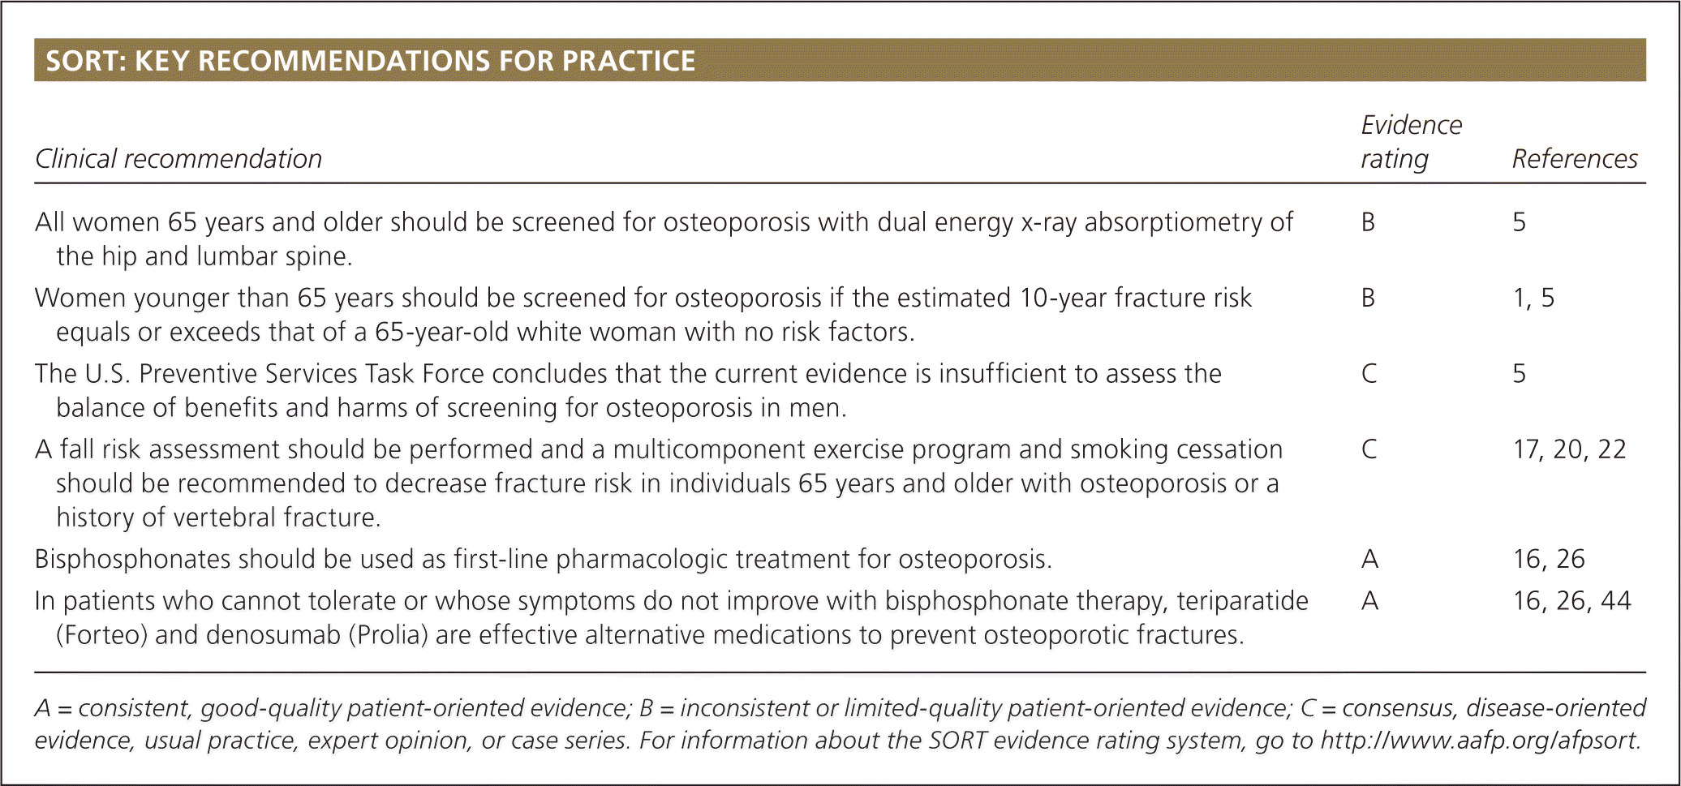

Slide 10
Drug to Drug interactions and Side effects with Fosamax
Drug to Drug interactions:
Calcium Supplements/Antacids-interfere with absorption of Fosamax
Aspirin- increased risk for upper GI bleed
NSAIDS- increased risk for upper GI bleed
Ranitidine- bioavailability doubles. Increased risk of GI bleeding with dose > 10mg/d
Side Effects:
Esophageal irritation, GI upset
Heartburn
Constipation
Diarrhea
Low calcium levels in blood
Bone, joint or muscle pain
Severe jaw bone problems (osteonecrosis)
Unusual thigh bone fractures

Slide 11
Mechanism of Action
The normal remodeling of bone is initiated by osteoclastic activity. In response to microfractures and other damage to the bone, osteoclasts are drawn to the damaged area, attach to it’s surface and resorb the damaged and surrounding bone, creating a resorption pit. Resorption is accomplished by pseudopodia, which attach to the bone surface and secrete acids and enzymes that dissolve bone. The osteoclast leave and osteoblast move in by lining up to cover the surface of the pit and form new bone.
Bisphosphates adhere tightly to bone and by inhibiting osteoclastic activity, are potent inhibitors of both normal and abnormal bone resorption. Fosamax is a highly selective inhibitor of bone resorption and 100 to 500 times more potent than other drugs. It does not interfere with osteoclast recruitment or attachment, but it does inhibit osteoclastic activity. In addition to their inhibitory effect on osteoclasts, bisphosphonates appear to have a beneficial effect on osteoblasts. Bisphosphonates prevented osteocyte and osteoblast apoptosis.
There is no evidence that Bisphosphates are systematically metabolized. Any portion of the drug that is not distributed to the bone is largely excreted in the urine.
Bioavailability is decreased by 40% with any food. Must take 30 minutes or more before any food intake.

Slide 12
Prescriptions
Rogersville Family Practice Angel Hobbs, FNP student
754 Main Street DEA# 12345236920
Rogersville, Tn. 37857
Phone# 867-5309
Name: Marge Simpson DOB: 10-1-1956 Date: 3-11-2020
Address: 743 Evergreen Terrace Springfield
RX
Fosamax 10 mg
Sig: Take one tablet daily on an empty stomach for Osteoporosis. Take 30 (thirty) minutes before food intake.
Dispense: #30 (thirty)
Refills: 2 (two) Angel Hobbs, FNP-student

Slide 13
Rogersville Family Practice Angel Hobbs, FNP student
754 Main Street DEA#12345236920
Rogersville, Tn. 37857
Phone# 867-5309
Name: Marge Simpson DOB: 10-1-1956 Date: 3-11-2020
Address: 743 Evergreen Terrace Springfield
RX
Vitamin D 50,000 units
Sig: take 1 (one) capsule one time weekly
Dispense: #12 (twelve) Angel Hobbs, FNP-student
Refills: 0 (zero)

Slide 14
References
Jeremiah, M., Unwin, B., Greenawald, M., & Casiano, V. (2015). Diagnosis and Management of Osteoporosis. Retrieved 11 March 2020, from https://www.aafp.org/afp/2015/0815/p261.html
Osteoporosis Symptoms. (2019). Retrieved 11 March 2020, from https://www.healthline.com/health/osteoporosis-symptoms
Rosen, H. (2019). UpToDate. Retrieved 11 March 2020, from https://www.uptodate.com/contents/pharmacology-of-bisphosphonates
Uphold, C., & Graham, M. (2013). Clinical guidelines in Family Practice (5th ed., pp. 849-853). Gainesville: Barmarre Books, INC.
Woo, T., & Robinson, M. (2016). Pharmacotherapeutics for advance practice nurse prescribers (4th ed., pp. 542-545). Philadelphia: F.A. Davis Company.

